Slide 1
Blood type and compatibility chatbot
ChatBot PROJECT
Presented By:
Hima Manikanta Vasamsetti – Bonam Venkata Chalamayya engineering college

Slide 2
OUTLINE
Problem Statement
The process of blood donation and understanding blood type compatibility can be complex and confusing for donors, recipients, and healthcare professionals. Misinformation or lack of awareness about which blood types are compatible can lead to inefficiencies in blood donation and transfusion processes, potentially putting lives at risk. There is a need for a reliable, accessible, and user-friendly solution to provide accurate information and assist users in navigating the blood donation process.
Proposed System/Solution
We propose the development of a blood type and compatibility chatbot that leverages natural language processing (NLP) and secure data handling to assist users in understanding blood type compatibility, finding donation centers, scheduling appointments, and receiving personalized guidance throughout the blood donation process. This chatbot will serve as an educational and support tool, enhancing the efficiency and effectiveness of blood donation efforts.

Slide 3
OUTLINE
System Development Approach (Technology Used)
Watsonx Assistant
Result The developed chatbot successfully engages users in natural language conversations, providing accurate and timely information about blood type compatibility, donation eligibility, and procedural guidance. Users can easily find nearby donation centers, schedule appointments, and receive personalized recommendations based on their blood type and medical history. The chatbot's user-friendly interface and step-by-step guidance ensure a smooth and informed blood donation experience, ultimately contributing to higher efficiency and better healthcare outcomes.
Conclusion The blood type and compatibility chatbot represents a significant advancement in healthcare technology, offering a practical solution to enhance blood donation awareness and assistance. By providing personalized, secure, and accurate information through natural language interactions, the chatbot empowers donors and recipients, fosters community engagement, and supports healthcare professionals in saving lives. The integration of advanced technologies ensures continuous optimization and improvement of the chatbot's performance and user experience

Slide 4
OUTLINE
Future Scope
Enhanced AI Capabilities: Incorporate machine learning algorithms to continuously improve the chatbot's understanding and responses based on user interactions.
Multilingual Support: Expand the chatbot's language capabilities to cater to a wider audience, including non-English speaking users.
Integration with Healthcare Systems: Link the chatbot with hospital and blood bank databases for real-time updates on blood stock levels and urgent requirements.
Mobile Application: Develop a mobile app version of the chatbot to increase accessibility and convenience for users on the go.
Advanced Analytics: Implement advanced analytics to monitor usage patterns, identify areas for improvement, and measure the impact on blood donation rates.
References
Watsonx assistant tutorial

Slide 5
Problem Statement
Blood Type and Compatibility Chatbot: Empowering Donors and Recipients
User Interaction: Our blood type and compatibility chatbot engages users in natural language conversations, facilitating easy access to critical information about blood types, compatibility, and donation procedures. Users interact seamlessly with the chatbot, asking questions such as which blood types they can receive based on their own blood type and which blood types can receive their donations. This intuitive interaction style ensures that users feel supported and empowered throughout their engagement with the chatbot.
Information Collection: The chatbot prompts users to provide essential information such as their blood type, medical history, and donation preferences. This data collection process prioritizes security and compliance with healthcare regulations, ensuring that user information is handled confidentially and responsibly. By securely storing this information, the chatbot enables personalized assistance and tailored recommendations based on the specific needs of donors and recipients.
Query Handling: Equipped with advanced algorithms, the chatbot efficiently addresses user inquiries regarding blood donation eligibility, compatibility issues, and procedural details. It provides accurate and comprehensive responses to queries about blood type compatibility, donation center locations, donation scheduling, and more. Users can rely on the chatbot for reliable information that supports their decision-making process regarding blood donation

Slide 6
Proposed Solution
User Interaction: Our blood type and compatibility chatbot engages users in natural language conversations, facilitating easy access to information about blood types, compatibility, and donation procedures. Users interact seamlessly with the chatbot, asking questions about which blood types they can receive based on their own blood type and which blood types can receive their donations. This natural interaction style ensures that users feel comfortable and supported throughout their engagement with the chatbot.
Information Collection: The chatbot prompts users to provide essential information such as their blood type, medical history, and donation preferences. This data collection process is secure and adheres to strict privacy regulations, ensuring that user information is handled confidentially and responsibly. By securely storing this information, the chatbot enables personalized assistance and tailored recommendations based on user-specific needs.
Query Handling: Equipped with advanced algorithms, the chatbot efficiently handles user inquiries regarding blood donation eligibility, compatibility issues, and procedural details. It provides accurate and helpful responses to queries about blood type compatibility, donation center locations, donation scheduling, and more. Users can rely on the chatbot for reliable information that supports their decision-making process regarding blood donation.
User Guidance: The chatbot offers step-by-step guidance to users, directing them on how to proceed with their blood donation journey. Whether it's understanding eligibility criteria, finding nearby donation centers, or scheduling donation appointments, the chatbot ensures that users are well-informed and empowered to take meaningful action. Clear instructions and timely reminders help users navigate the donation process seamlessly.

Slide 7
Proposed Solution
Feedback Mechanism: To enhance its performance and user satisfaction, the chatbot incorporates a robust feedback mechanism. Users are encouraged to provide feedback on their interaction experience, allowing the chatbot to continuously optimize its responses and functionalities. This iterative improvement process ensures that the chatbot remains up-to-date with best practices in blood donation and meets the evolving needs of its users effectively.
Community Engagement: Beyond providing information and guidance, the chatbot actively promotes community engagement in blood donation initiatives. It highlights upcoming donation events, shares success stories from donors and recipients, and encourages participation through virtual tours of donation centers. By fostering a sense of community and altruism, the chatbot contributes to increasing awareness about the importance of blood donation and its lifesaving impact.
Conclusion: In conclusion, our blood type and compatibility chatbot represents a significant advancement in healthcare technology, leveraging artificial intelligence to enhance blood donation practices. Through natural language interaction, secure information handling, and proactive community engagement, the chatbot serves as a valuable tool for promoting blood donation awareness, assisting donors and recipients, and ultimately contributing to improved healthcare outcomes. It exemplifies the transformative potential of technology in addressing critical societal needs and advancing public health initiatives

Slide 8
System Approach
The "System Approach" section outlines the overall strategy and methodology for developing and implementing the rental bike prediction system. Here's a suggested structure for this section:
System requirements : windows 11 operating system , 8GB RAM, I3 Processor
Library required to build the model : IBM Watsonx assistant

Slide 9
Result
Streamlining Blood Donation Assistance: Our blood type and compatibility chatbot serves as an innovative tool designed to enhance knowledge about blood donation and provide critical assistance to donors and recipients alike. Users interact seamlessly with the chatbot, receiving comprehensive guidance on blood types, compatibility information, and donation procedures. This initiative aims to streamline the process of blood donation, ensuring that users have access to accurate and timely information at their fingertips.
Natural Interaction: Utilizing advanced natural language processing (NLP) capabilities, the chatbot enables users to interact naturally, asking questions about which blood types they can receive based on their own blood type and which blood types can receive their donations. This user-friendly approach demystifies complex medical information, empowering donors and recipients to make informed decisions.
Secure Data Handling: The chatbot prioritizes data security by securely collecting and managing necessary information such as blood type, medical history, and donation preferences. This ensures confidentiality and compliance with healthcare regulations, instilling trust and confidence among users.
Efficient Query Resolution: Equipped with robust algorithms, the chatbot efficiently resolves user queries regarding blood donation eligibility, compatibility issues, and procedural inquiries. It delivers accurate responses and step-by-step guidance, enhancing user satisfaction and engagement throughout their interaction.
Continuous Improvement: A feedback mechanism facilitates continuous improvement of the chatbot's performance and user experience. By gathering user feedback and analyzing interaction patterns, the chatbot evolves to meet evolving user needs and technological advancements in blood donation practices.
Community Engagement: Beyond informational support, the chatbot actively promotes community engagement in blood donation initiatives. It highlights upcoming donation events, provides virtual tours of donation centers, and encourages participation, thereby fostering a culture of altruism and healthcare awareness within the community.
Conclusion: In conclusion, our blood type and compatibility chatbot represents a pivotal advancement in healthcare technology, leveraging artificial intelligence to enhance blood donation practices. By providing personalized assistance, secure data handling, and fostering community engagement, the chatbot plays a crucial role in promoting lifesaving blood donations and improving healthcare outcomes. It exemplifies the transformative potential of technology in addressing societal challenges and advancing public health initiatives

Slide 10
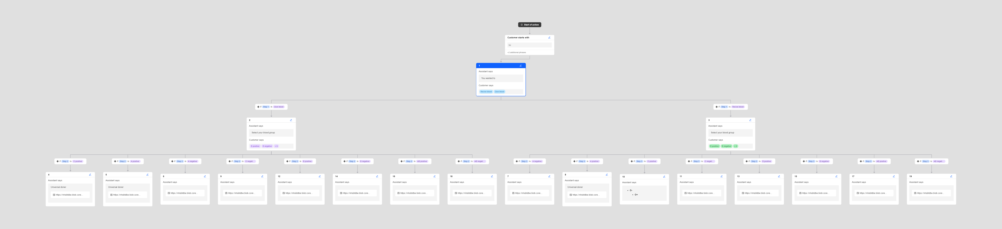
Result

Slide 11
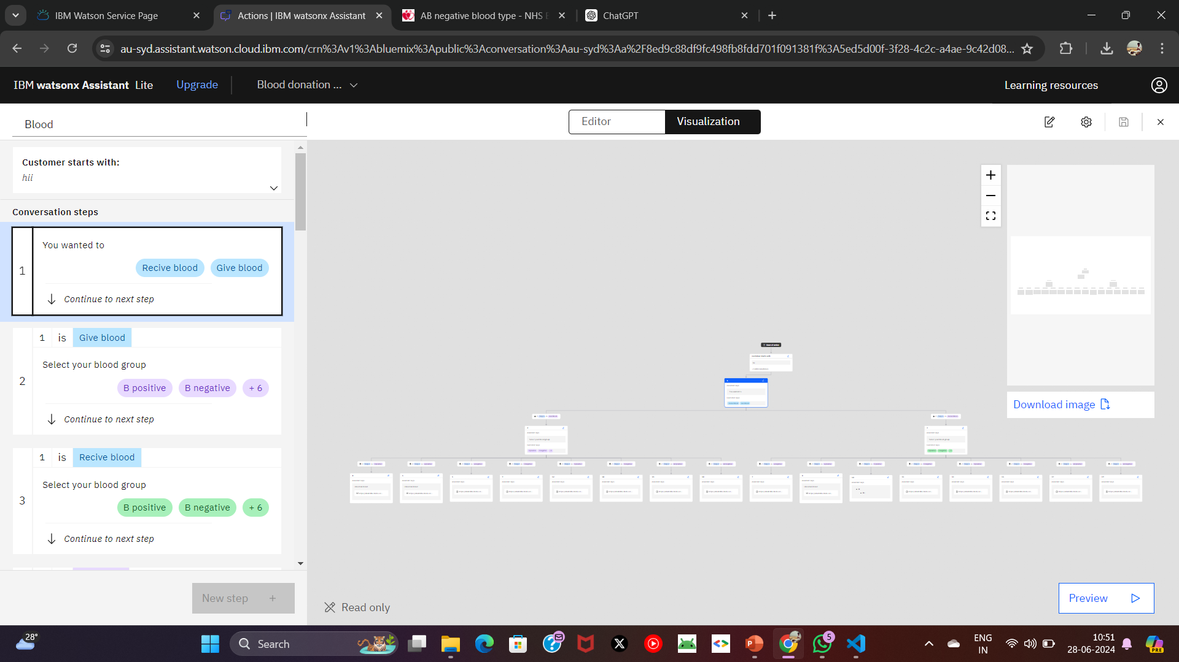
Result

Slide 12
Conclusion
Practical Solution: The development of a blood type and compatibility chatbot offers a practical solution to enhance blood donation awareness and assistance. By leveraging advanced natural language processing (NLP) and secure data handling, the chatbot effectively educates users about blood types, compatibility, and donation procedures. It serves as a reliable resource for donors, recipients, and healthcare professionals, facilitating informed decisions and enhancing overall efficiency in blood donation processes.
Timely and Accurate Information: Utilizing NLP algorithms, the chatbot provides timely and accurate information regarding which blood types a user can receive based on their own blood type and which blood types can receive their donations. This feature is critical in emergencies and planned medical procedures, ensuring that users have access to lifesaving information when it matters most.
User-Friendly Interface: With a user-friendly interface and intuitive navigation, the chatbot simplifies complex medical information into accessible insights. It guides users through the intricacies of blood donation compatibility, fostering confidence and understanding among donors and recipients alike.
Continuous Improvement: Incorporating a feedback mechanism, the chatbot continuously learns from user interactions to improve its responses and user experience. This iterative process ensures that the chatbot remains up-to-date with medical guidelines and user preferences, enhancing its effectiveness over time.
Community Engagement: By promoting blood donation events and offering virtual tours of donation centers, the chatbot actively engages the community. It encourages participation in blood donation drives and fosters a sense of social responsibility among users, thereby contributing to the overall health and well-being of the community.
Conclusion: In conclusion, the development of a blood type and compatibility chatbot represents a significant advancement in healthcare technology. By providing personalized assistance, timely information, and fostering community engagement, the chatbot not only facilitates smoother blood donation processes but also plays a crucial role in saving lives. It exemplifies the potential of technology to improve healthcare outcomes and enhance public health initiatives, ultimately making a positive impact on society as a whole.

Slide 13
Future scope
Personalized Assistance:
Utilizing machine learning algorithms, our blood type chatbot offers personalized guidance based on user history and preferences. By analyzing past interactions, it tailors recommendations for blood donation centers, eligibility criteria, and specific blood type compatibility, ensuring each user receives relevant and accurate information aligned with their needs and circumstances.
Multilingual Support:
To enhance accessibility, our chatbot integrates multilingual capabilities. It provides information in multiple languages, accommodating diverse communities and ensuring that language barriers do not hinder access to critical blood donation information. This feature supports a broader audience, fostering inclusivity and encouraging participation in blood donation initiatives across different linguistic backgrounds.
Virtual Tours and Events:
Enhancing user engagement, the chatbot offers virtual tours of blood donation centers and reminders for donation events. These virtual experiences allow users to explore donation facilities remotely, familiarize themselves with procedures, and stay informed about upcoming opportunities to contribute to the community through blood donation.
By integrating these features, our blood type chatbot not only educates and assists users in making informed decisions about blood donation but also promotes community engagement and participation in lifesaving initiatives. It serves as a reliable resource for donors, recipients, and healthcare providers alike, supporting the mission of improving healthcare outcomes through accessible and personalized information delivery

Slide 14
References
IBM watsonx Assistant tutorial

Slide 15
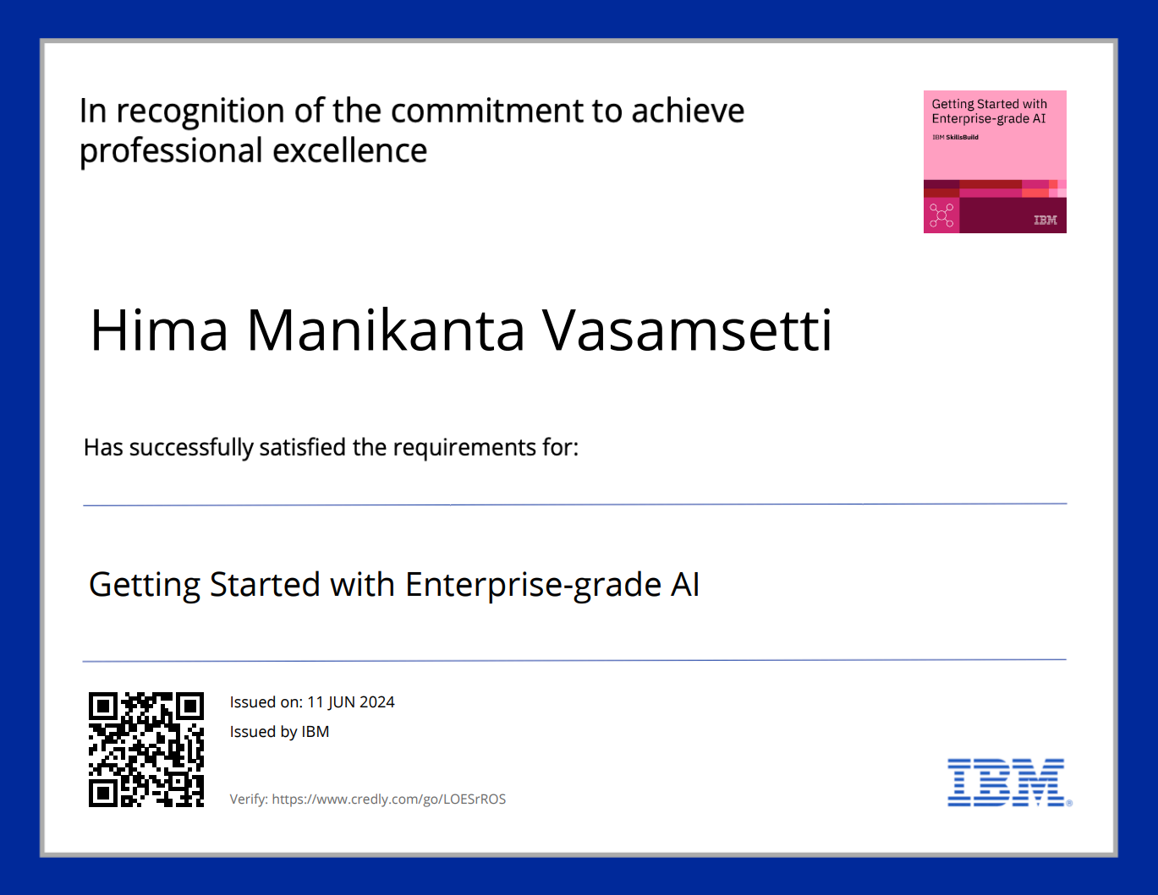
course certificate 1

Slide 16
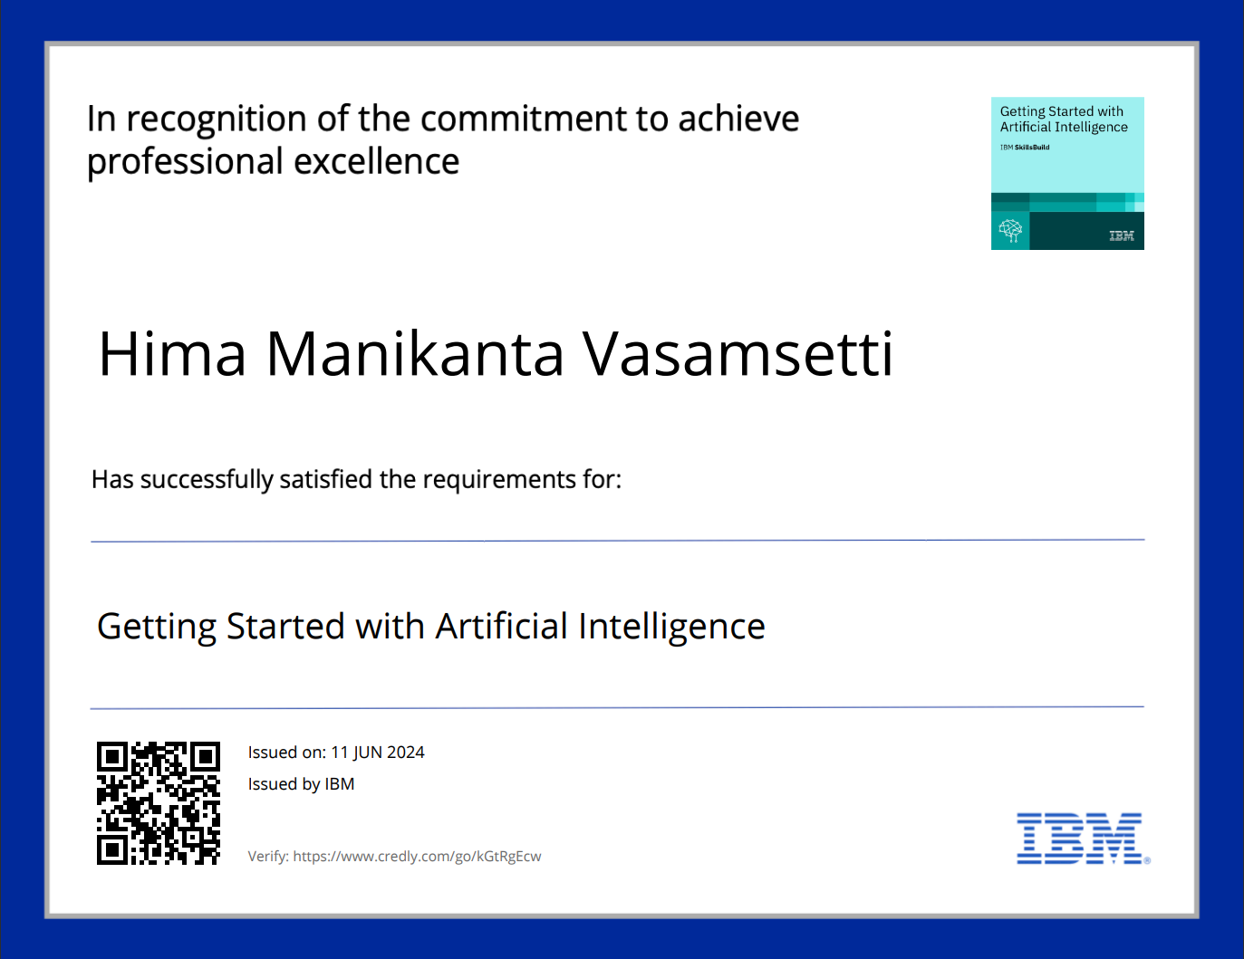
course certificate 2

Slide 17
THANK YOU

